Slide 1
yRelocate?
Group Two:
Joe Reynolds, Trupti Samant,
Maryam Samani, Trent Gebben and Bill Frye

Slide 2
Core Questions
Based on what a person values, can we identify what neighborhood a person should live in?
What factors can we use to determine what neighborhood a person would want to live in?
How can we classify people into different groups?

Slide 3




APIs/Data Sources Used

Slide 4
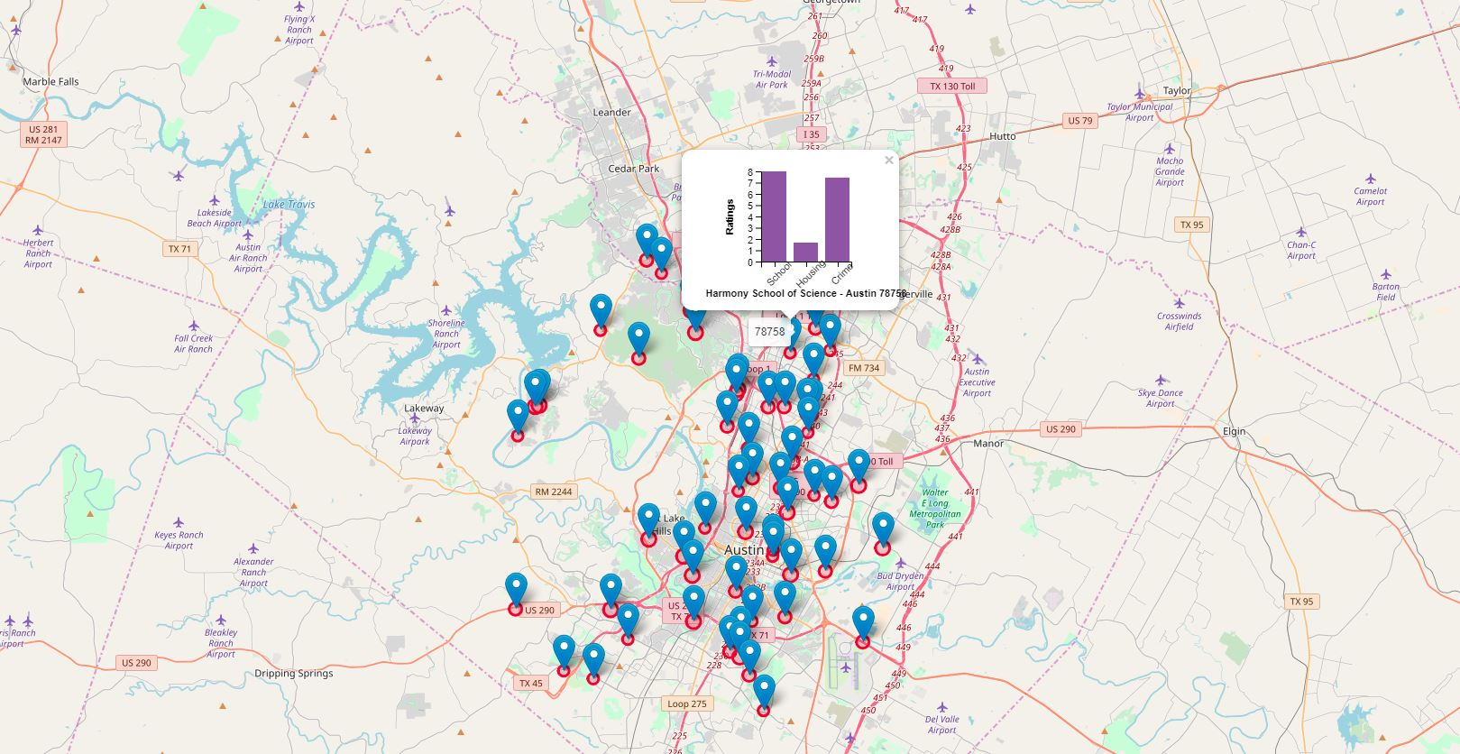
Example Family Map

Slide 5
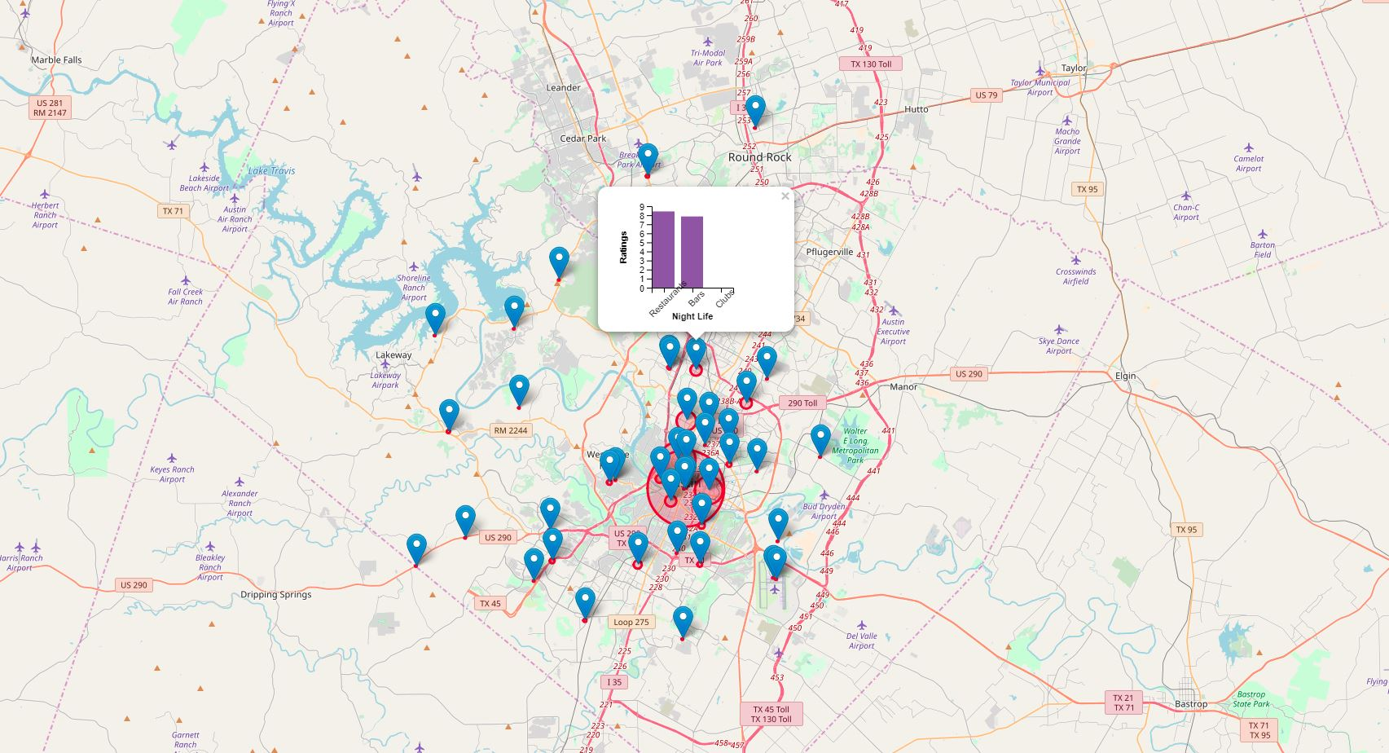
Example Single Map

Slide 6
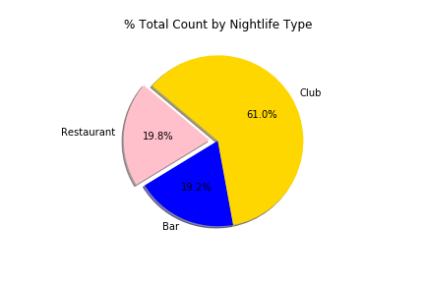
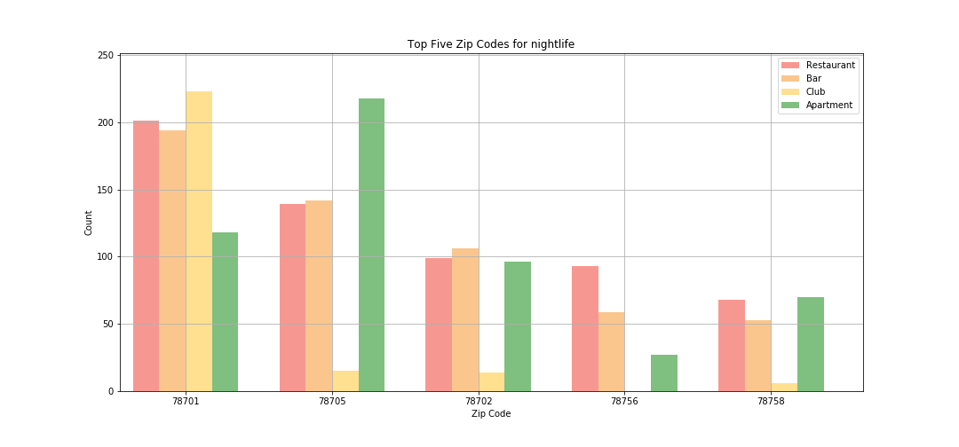
Nightlife Findings

Slide 7
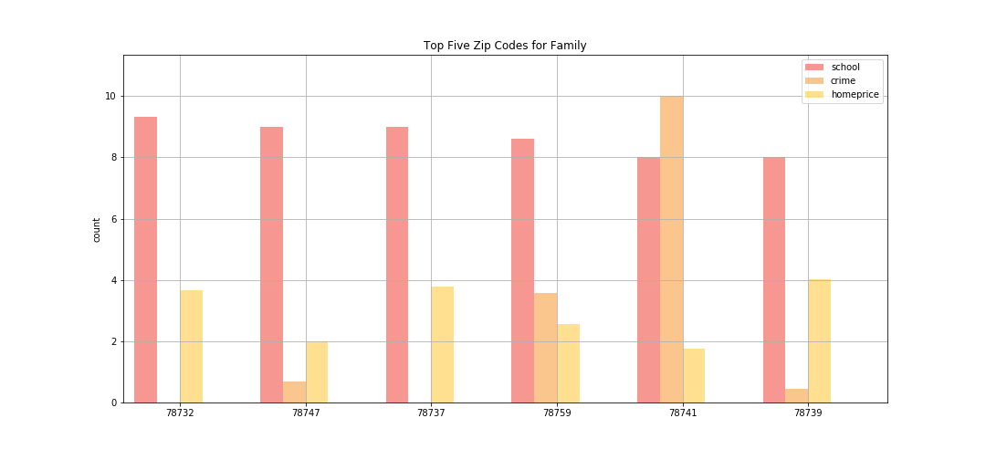
Family Findings

Slide 8
Data Exploration and Clean Up
Finding the Right APIs
Assumptions on what Certain groups of people value
Standardizing Ratings

Slide 9
Expansion On Future Projects
Adding Front End
Incorporating Machine Learning

